Slide 1

A Web Based Stress Relief & Wellness Platform
- Created by : Prathmesh Harischandrakar

Slide 2
What Is BreatheSync ?
BreatheSync is a web application focused on reducing stress and promoting mental well-being.
It offers content like:
1.Relaxation Music Videos
2.Guided yoga and meditation Videos
3.Videos of Motivational Speakers
4.Spiritual content for inner peace.
An integrated chatbot supports users emotionally using Natural Language Processing (NLP). Help user to Navigate user to watch which section video based on their condition eg- if he is unmotivated suggest to watch motivational speakers videos.

Slide 3
Need For Website
Rising stress, anxiety, and burnout among students and professionals.
Limited access to instant, trusted mental wellness resources.
Growing reliance on digital platforms for emotional support and self-care.
Lack of unified platforms that combine guided relaxation, meditation, and motivational support.
Users need personalized suggestions based on their emotional condition.
Need for a user-friendly and free solution with emotional intelligence and real-time assistance.

Slide 4
Problem Statement
High levels of stress and anxiety among youth and working professionals.
Lack of free, focused digital platforms offering immediate relaxation and motivation.
No emotional assistant that understands user moods and suggests relevant content.

Slide 5
Objectives
Develop a web platform with intuitive UI and secure authentication.
Offer categorized videos for relaxation, motivation, spirituality, and meditation.
Integrate a responsive chatbot that:
Analyzes user emotions
Suggests appropriate videos according to emotions eg stressed
Guides breathing techniques
Collect user feedback to evaluate effectiveness.

Slide 6
Hardware & Software Requirments
Category | Component | Details
Software | Frontend | HTML5, CSS3, JavaScript, Bootstrap
 | Backend | Python, Flask
 | Database | SQLite (with SQLAlchemy ORM)
 | NLP Library | TextBlob
 | Templating Engine | Jinja2
Hardware | Device | Laptop / PC / Mobile
 | Internet | Required
 | Browser | Chrome

Slide 7
Digrams -
USECASE
ClASS
ERD

Slide 8
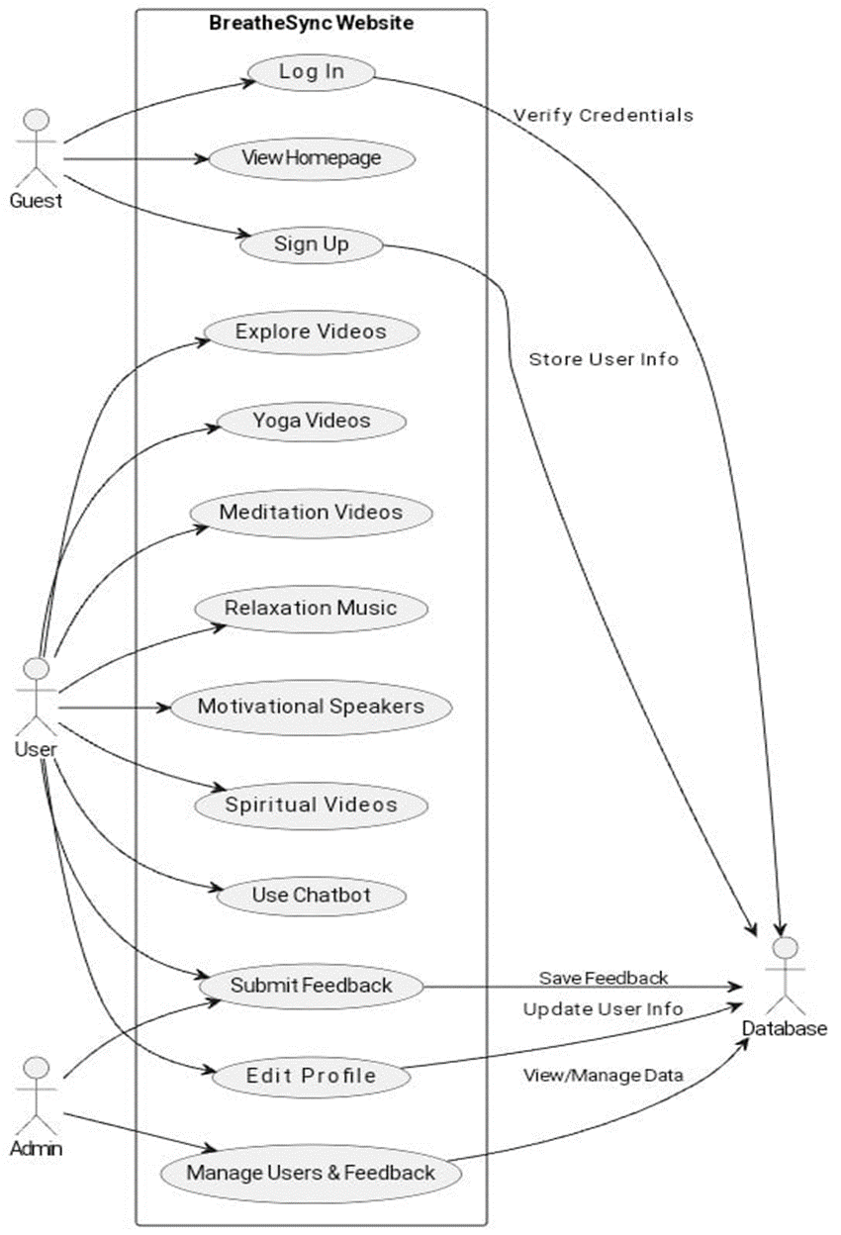

Slide 9
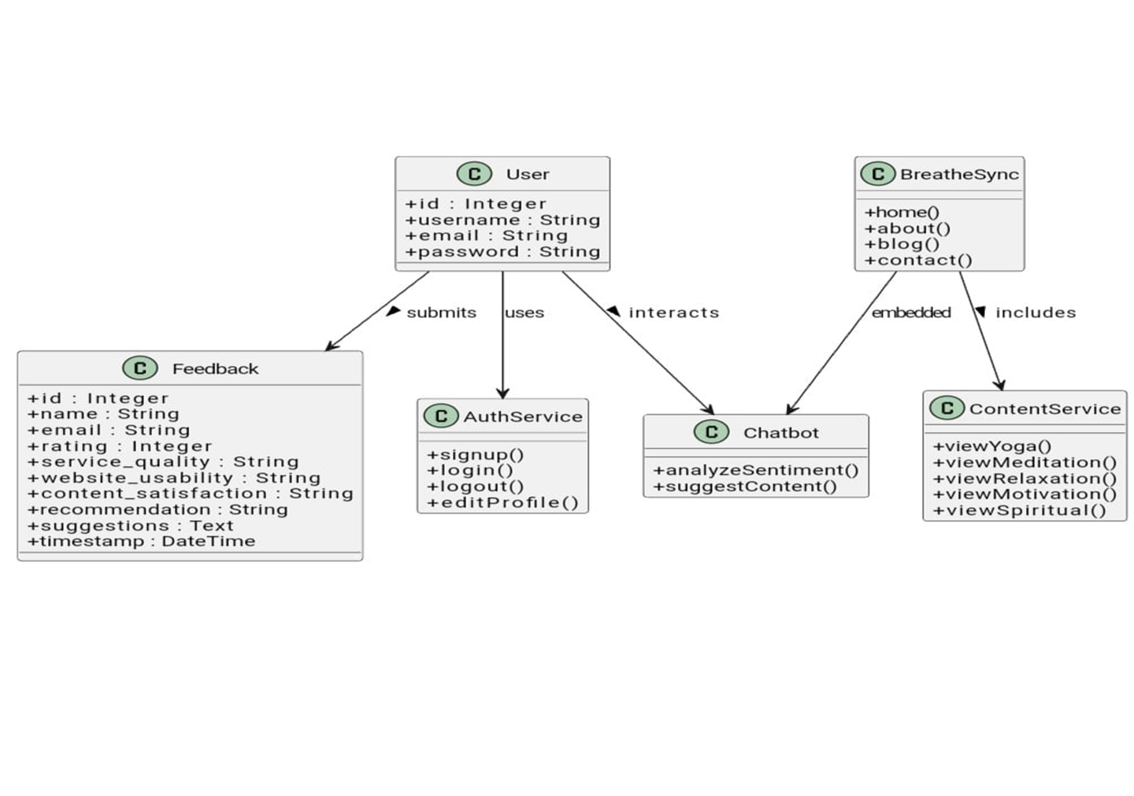

Slide 10
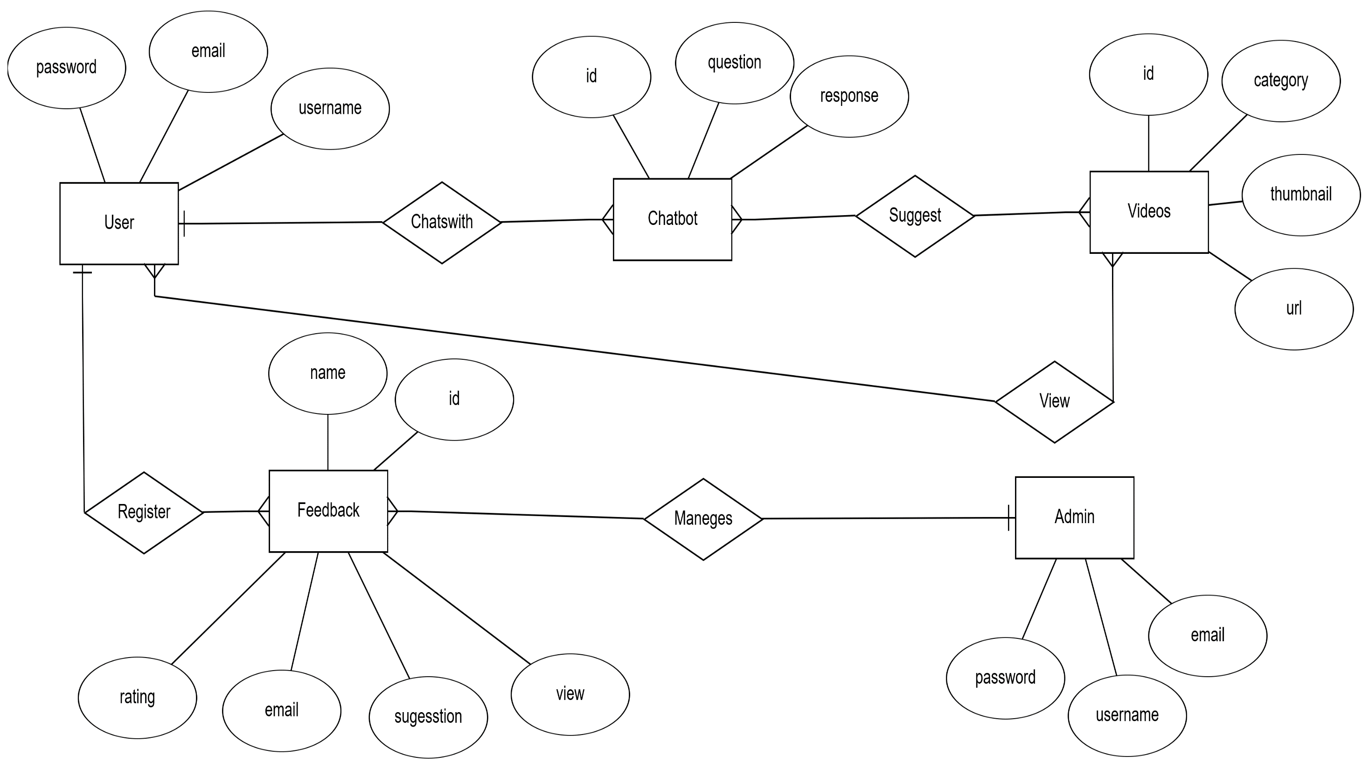

Slide 11
Form Design
User Signup Form Fields:
Name
Email Address
Password
Purpose : To collect user Information and create Account in website
Features:
Input validation(eg email ,name etc)
Checks for existing email to prevent duplicates
On success, user is automatically logged in
Includes Terms & Conditions checkbox (mandatory to submit)

Slide 12
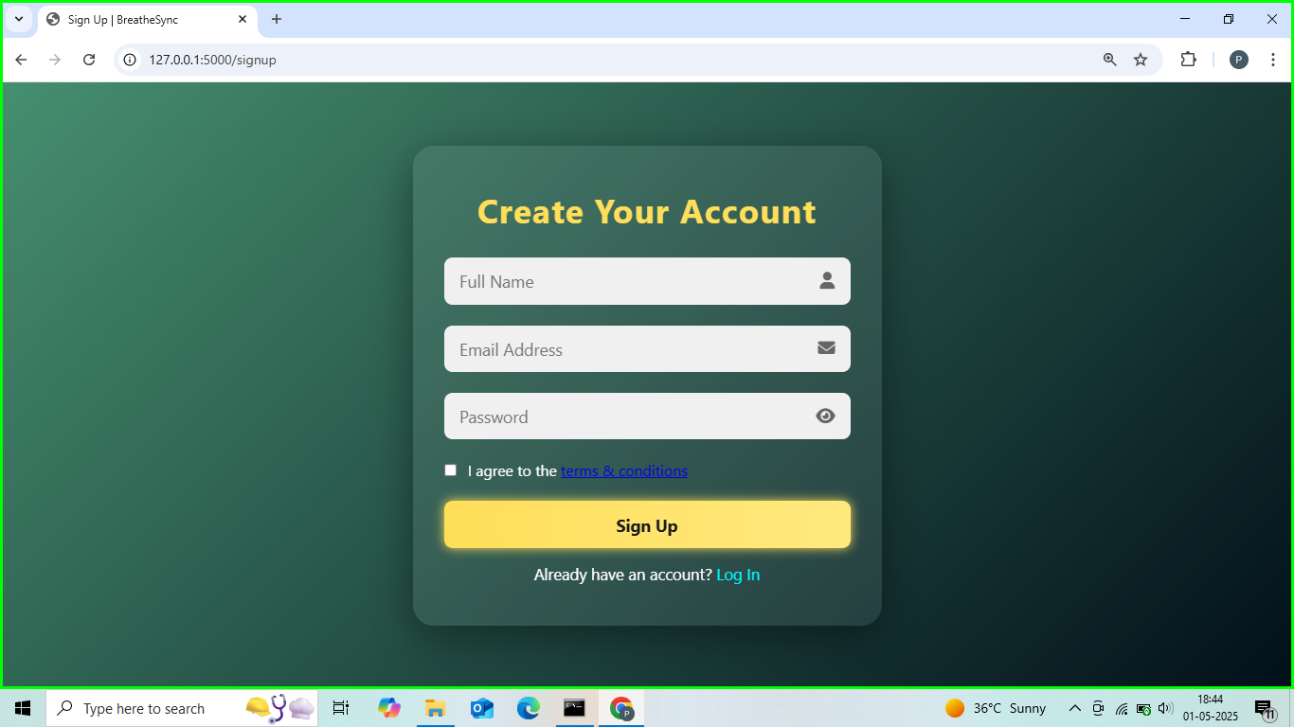

Slide 13
Form Designs
User Login form
Field:
email
password
Purpose: to logging in website
Features:
Requires registered email and password
Displays clear error messages on invalid attempts
On success, starts a user session and redirects to homepage
Displays user profile initials and name in navbar

Slide 14
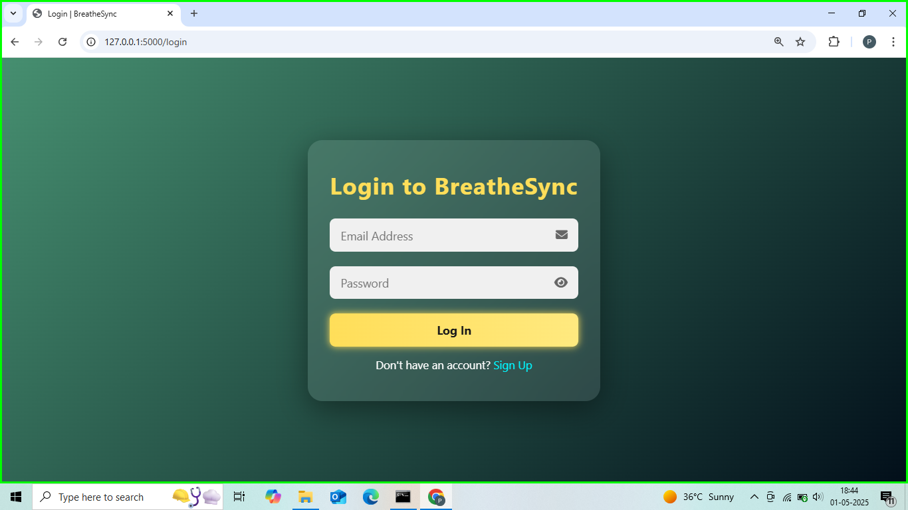

Slide 15
Form Designs
Feedback Fields:
name , satisfaction
email , suggestions
rating
quality
usability
Purpose : To collect feedback from user and update website as per their suggestions
Features:
Accepts name, email, rating, and suggestions
Feedback stored in SQLite database and exported to CSV
Displays submitted feedbacks
Collects detailed inputs

Slide 16
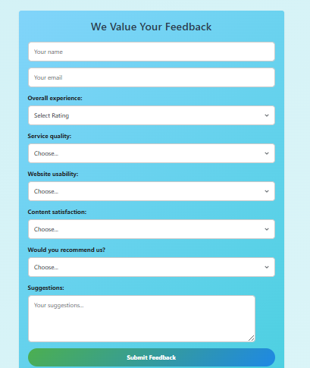

Slide 17
Form Designs
Edit Profile Fields:
name
email
old password
new password
Purpose : to give user usability to update his profile like name password.
Features:
Allows user to update username and email
Checks old password before allowing password update
Includes option to delete account permanently
Updates stored details in the SQLite database
Protects access — only logged-in users can edit their profile

Slide 18
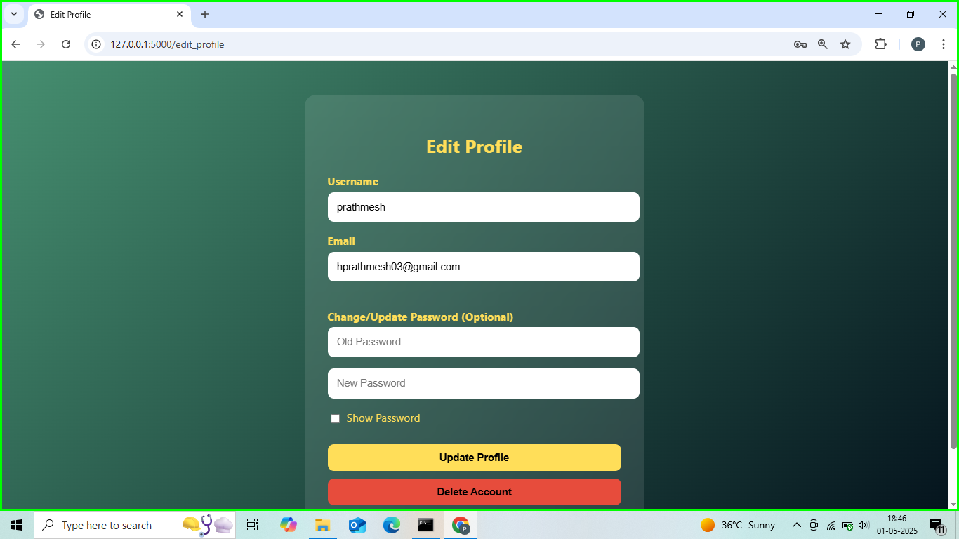

Slide 19
Database Design
Table Name | Field Name | Data Type | Description
user | id | INTEGER (PK) | Unique user ID
 | username | VARCHAR(20) | Full name of the user
 | email | VARCHAR(20) | User’s email address (must be unique)
 | password | VARCHAR(100) | Encrypted password (using hashing)

Slide 20
Table Name | Field Name | Datatype | Description
feedback | id | INTEGER(PK) | Unique Feedback id
 | name | VARCHAR(20) | Name of person submitting feedback
 | email | VARCHAR(20) | Email address of the user
 | rating | INTEGER | Overall Rating
 | service_quality | VARCHAR(20) | Rating of service quality
 | website_usablity | VARCHAR(20) | Rating of site usablity
 | content _satisfaction | VARCHAR(20) | Rating of content quality
 | recommendation | VARCHAR(20) | Whether the user recommend site
 | suggestions | TEXT | Suggestions or comments
 | timestamp | DATETIME | Sunmission date and time

Slide 21
Future Scope
Integrate virtual counseling for live support.
Develop AI-powered content recommendations.
Enhance sentiment analysis with multilingual NLP.
Add animated breathing guides and voice guidance.
Launch a mobile app for on-the-go access.
Create an admin dashboard for real-time analytics.
Build a community forum for peer support.
Add multilingual support and accessibility features.

Slide 22
Bilbography
Flask Documentation – Official guide for Flask, the Python-based web framework used to build the backend of BreatheSync. Source: https://flask.palletsprojects.com
SQLAlchemy Documentation – Reference for the SQLAlchemy ORM, used for interacting with the SQLite database. Source: https://docs.sqlalchemy.org
TextBlob Documentation – Library used for natural language processing (NLP) to analyze user sentiment in the chatbot. Source: https://textblob.readthedocs.io
Bootstrap Documentation – CSS framework used for responsive UI and mobile-friendly design. Source: https://getbootstrap.com
YouTube – Wellness and motivational videos were sourced from credible channels for categories like meditation, yoga, and relaxation. Source: https://www.youtube.com

Slide 23
Thank You
Created By: Prathmesh Harischandrakar &Chirag Shetty
Project Guide:Dr Abhijit Parchure
"Breathe in peace, breathe out stress."

